Slide 1
PhotonHub
PHACTORY
The start of your Supported
Photonics Innovation Journey

Slide 2




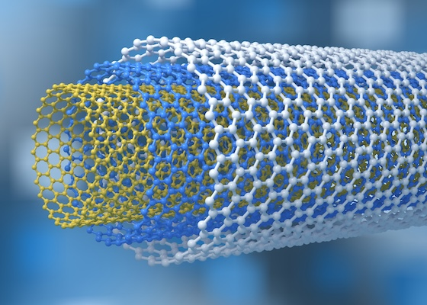
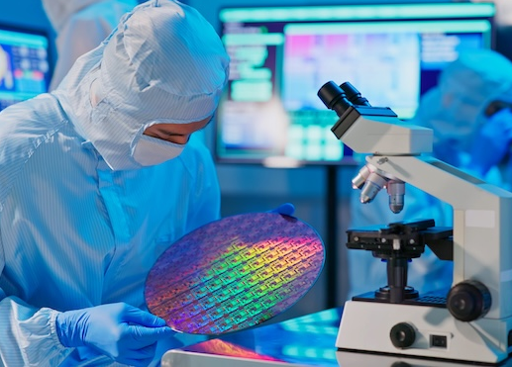


8 key digital technologies enabling the processes of discovery, innovation and digitalisation
The science and technology that innovates with light
Photonics
Advanced manufacturing
Biotechnology
Advanced materials
Nanotechnology
Nanoelectronics
Artificial intelligence
Cyber security

Slide 3



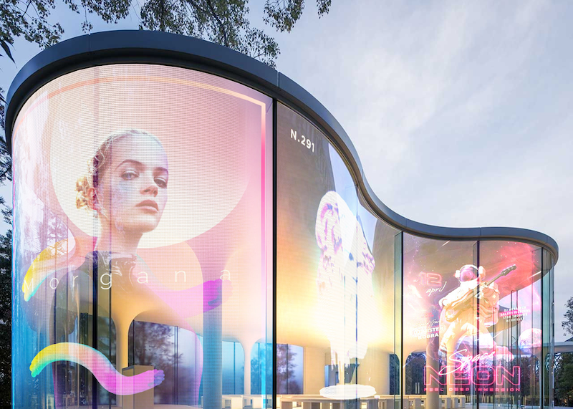




Photonics: an innovative technology real-world impact to improve the quality of life
LED lighting
Solar energy
Fiber internet
High resolution displays
Lasers in manufacturing
Medical optics
Machine vision
AR and VR

Slide 4
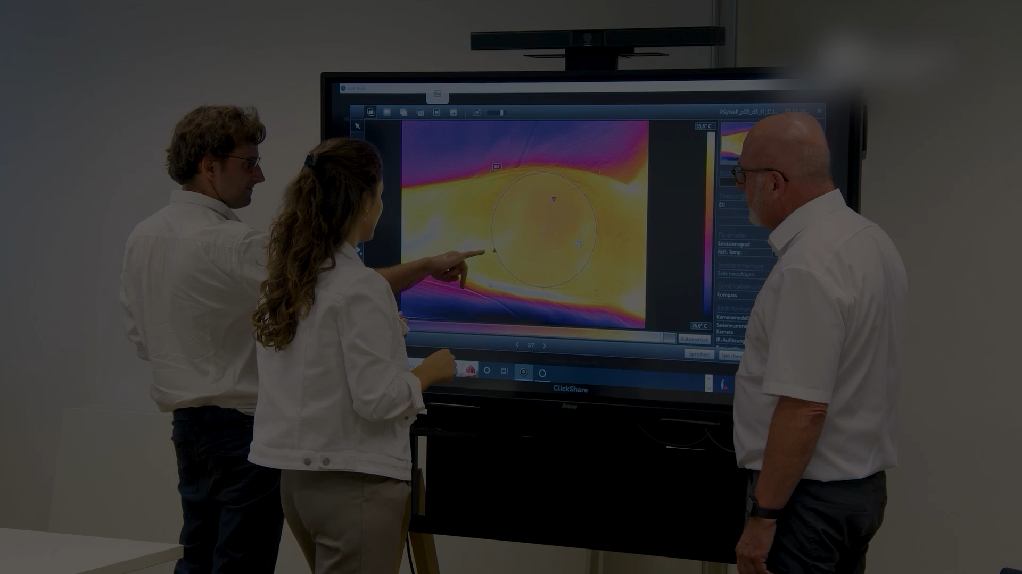
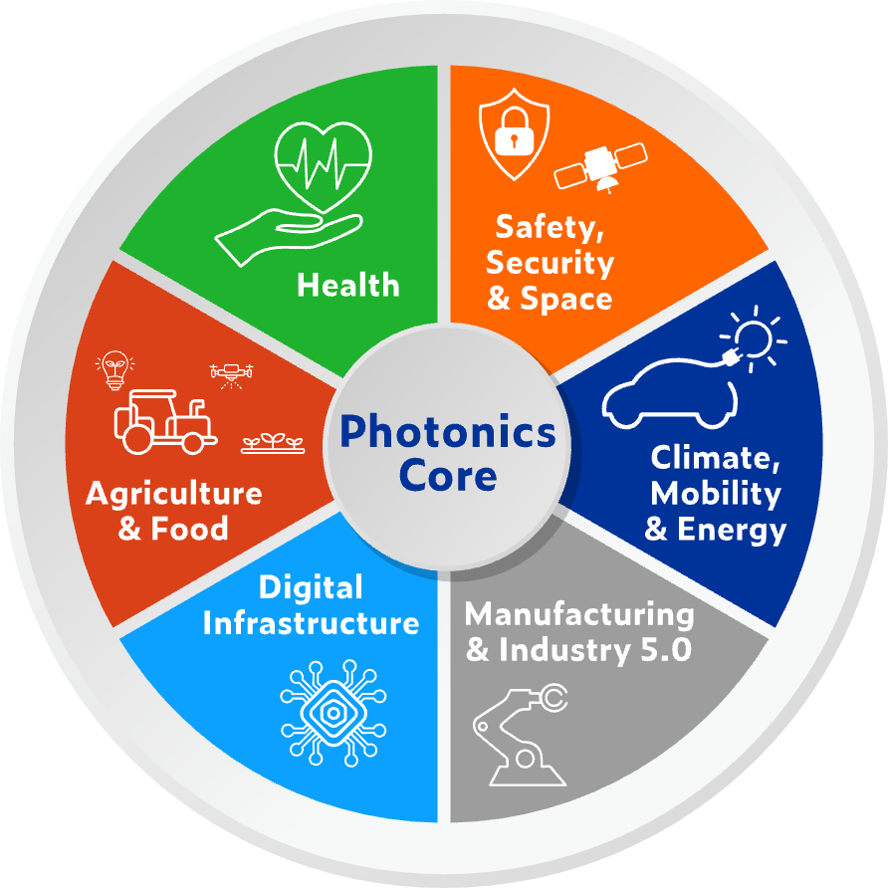

PHOTONICS driving innovation across all industry domains

Slide 5

European top experts support your innovation providing deep tech support and business & investment coaching
Technology Expertise
Business and
Investment Expertise
Technology Expertise
Expert
Consulting
Knowledge
Team
Training
Team
Conversation
Growth
Advice
Trust
Research
Prototyping Services
Pilot Lines and Foundries
Prototyping Services
Pilot Lines and Foundries
Proof-of-concept (POC)
Prototype
Pilot
Minimum viable product (MVP)

Slide 6
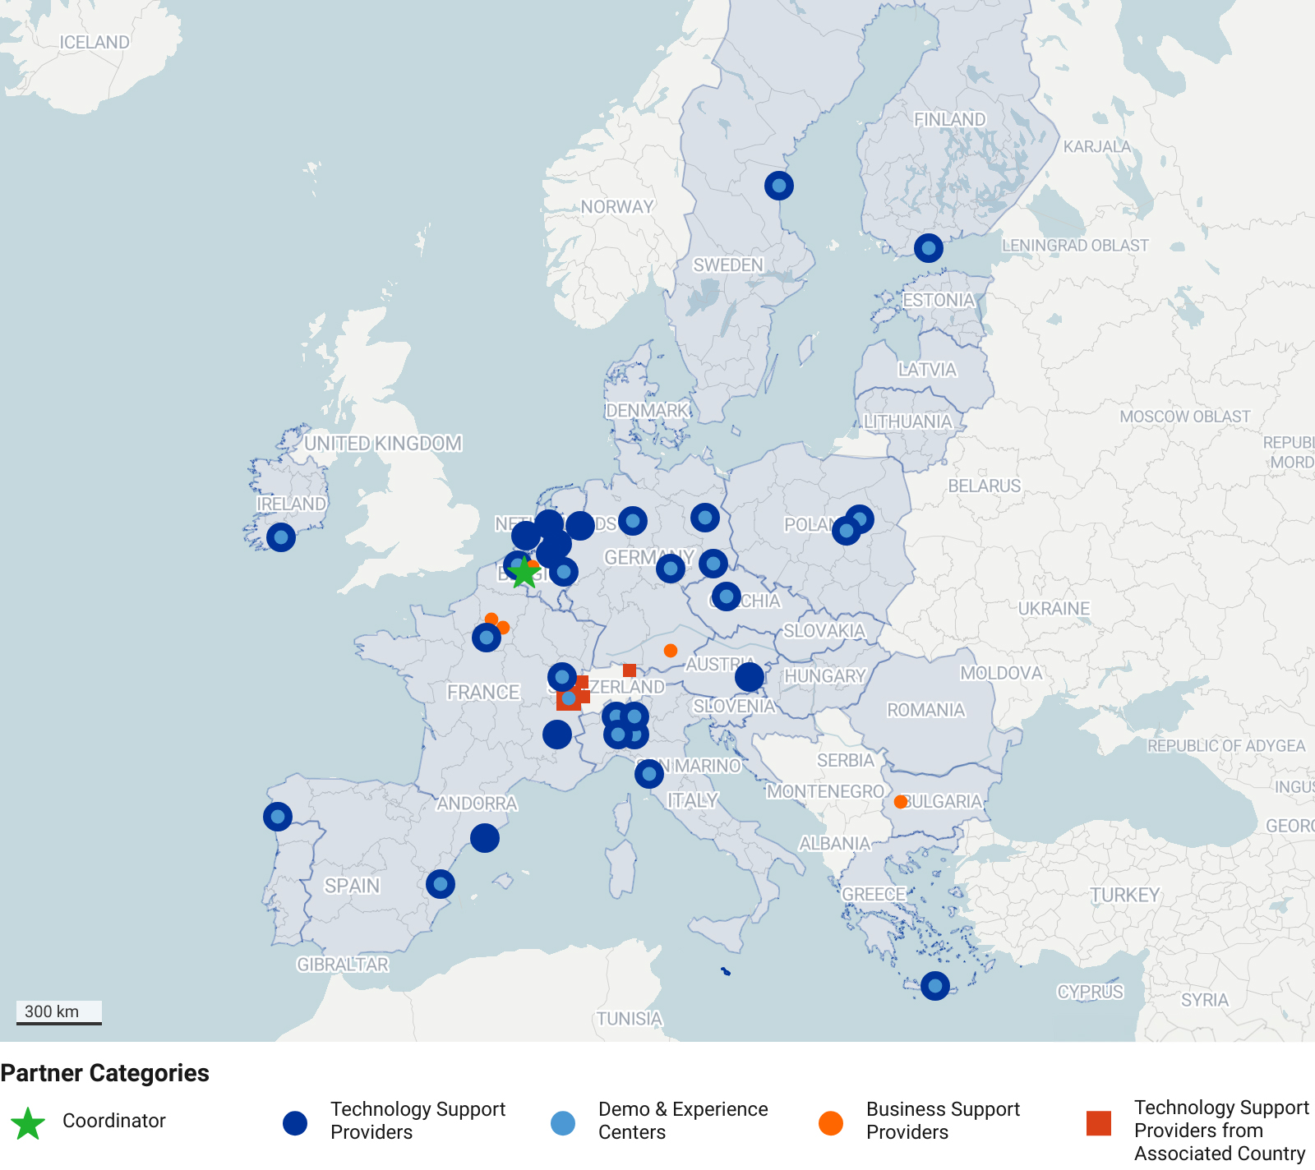
Introducing the project’s partners
30
Technology support partners
3
Business
support partners

Slide 7

Strongly subsidised projects up to 85% of the project’s budget
TRL 2-7: Innovation projects
Subsidy Levels
First €40k of innovation project budget fully subsidised; 85% of total budget subsidised thereafter*
(*Except for LSCs where it is 50% of total budget subsidised.)
Illustrative examples:
Total innovation project budget |  | Subsidised by PhotonHub |  | Cash contribution of company
€ 50k € 100k € 220k |  | € 48.5k € 91k € 193k |  | € 1.5k € 9k € 27k
=
+
=
+
=
+

Slide 8
Strongly subsidised projects up to 85% of the project’s budget
IRL 1-9: Business support
Available to EU-companies
Entrepreneurially minded Researchers and Start-Ups
  Launch Pad
Fast Scaling Ventures
  Scaling Club
Photonics-Enabled SMEs and LSCs
  Expert Mentoring

Slide 9
6 Steps to launch your photonics innovation
SELECT THE SERVICES OF INTEREST AND REGISTER ONLINE
TECHNOLOGY ORIENTEERING
We will contact you under NDA to explore your photonics ambition and identify the right technology approach and partners.
INITIAL EXPERT ASSESSMENT
Face-to-face expert meeting covering technical and business aspects, followed by a report with next steps (within 2 weeks).
PROJECT
PROPOSAL
Assignment of a project leader to help prepare and submit your tailored innovation proposal.
PROJECT
EVALUATION
Reviewing and scoring your proposal, invites you to an online Q&A, and delivers a formal report within one week.
CONTRACT SIGNING
AND KICK-OFF
Once granted, all partners sign the innovation project agreement and the project kicks off.

Slide 10


photonhub.eu
Start YOUR Supported
Photonics Innovation Journey
Apply online – NOW

