Slide 1
PhotonHub
PHACTORY
The start of your Supported
Photonics Innovation Journey

Slide 2




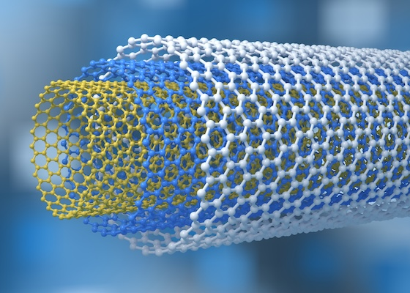
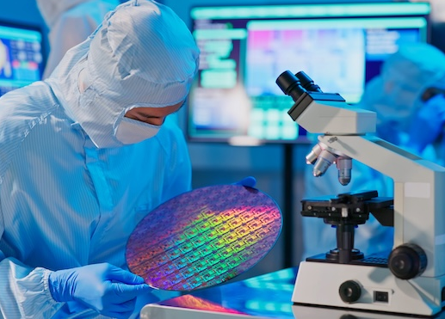


8 key digital technologies enabling the processes of discovery, innovation and digitalisation
The science and technology that innovates with light
Photonics
Advanced manufacturing
Biotechnology
Advanced materials
Nanotechnology
Nanoelectronics
Artificial intelligence
Cyber security

Slide 3



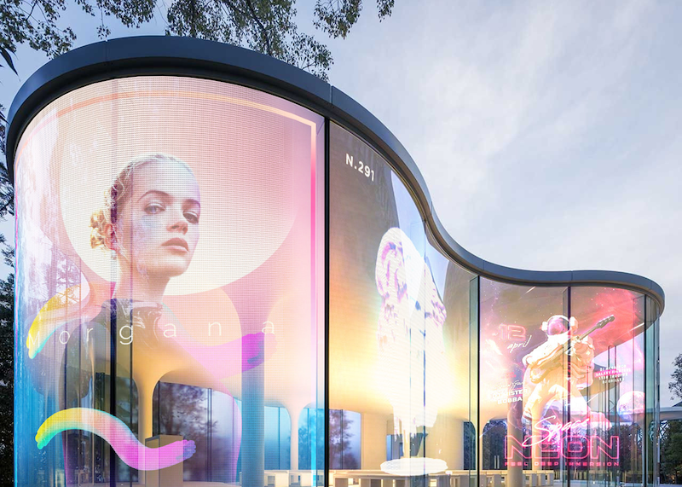




Photonics: an innovative technology real-world impact to improve the quality of life
LED lighting
Solar energy
Fiber internet
High resolution displays
Lasers in manufacturing
Medical optics
Machine vision
AR and VR

Slide 4
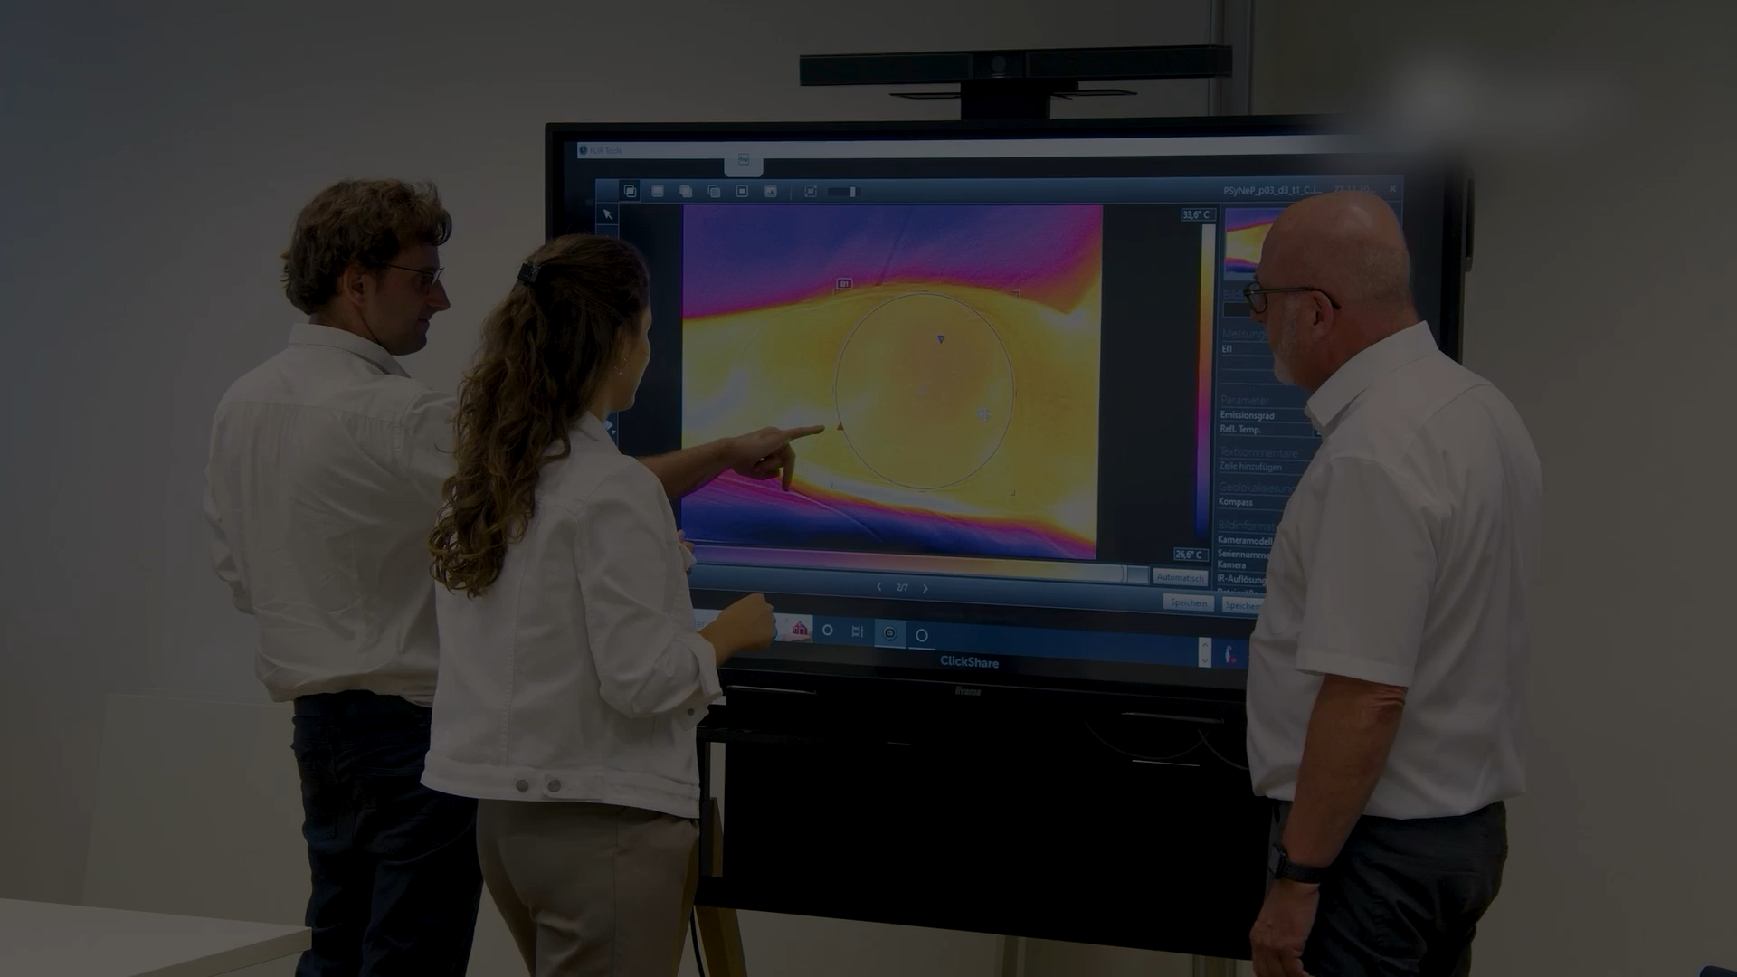
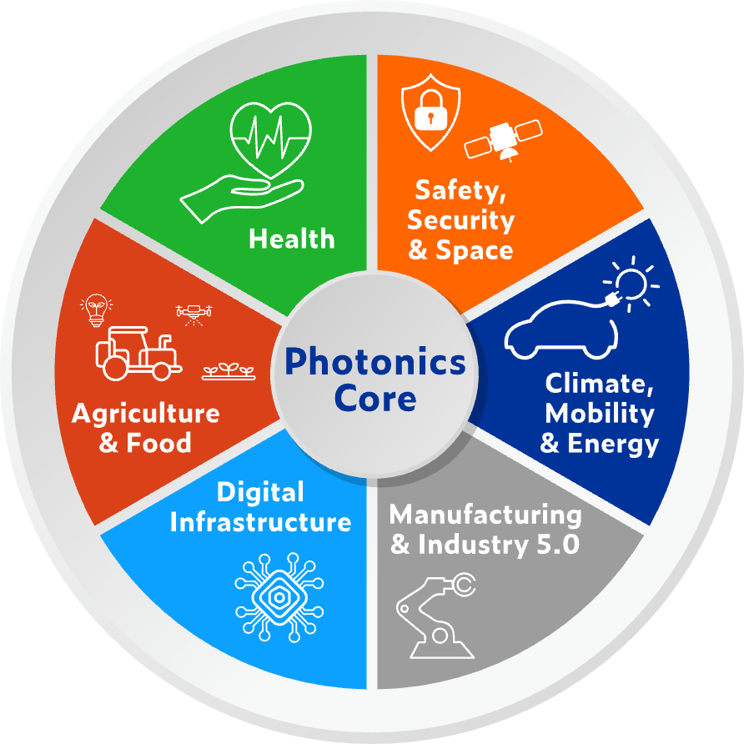

PHOTONICS driving innovation across all industry domains

Slide 5
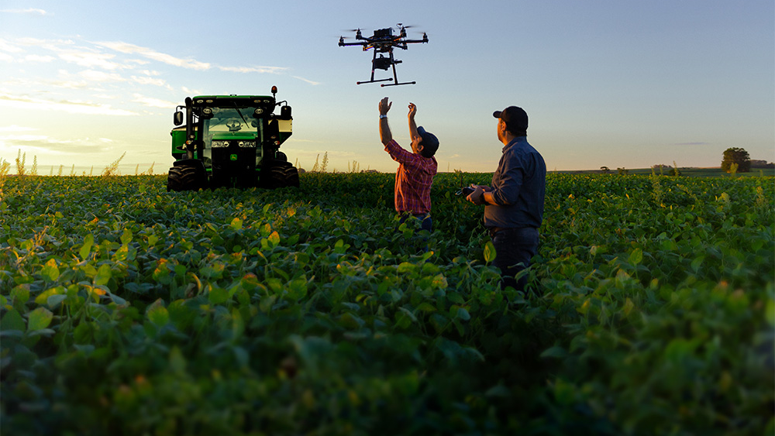

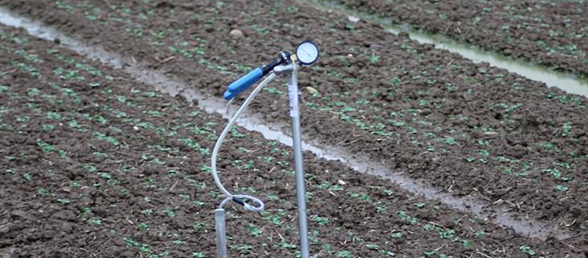
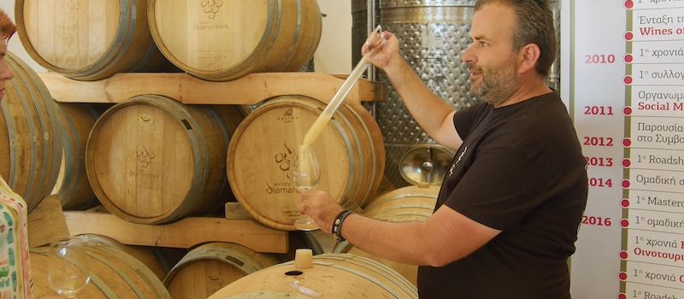
PHOTONICS IN
AGRICULTURE & FOOD
EXAMPLES OF SUPPORTED PROJECTS
Food quality
and safety assurance with light technology monitoring
Soil
monitoring benefitting from photonics technologies
DISCOVER HOW YOU CAN
Reduce energy costs
Optimise harvest yields
Assure food safety
Safeguarding wine quality
thanks to
optical sensors

Slide 6


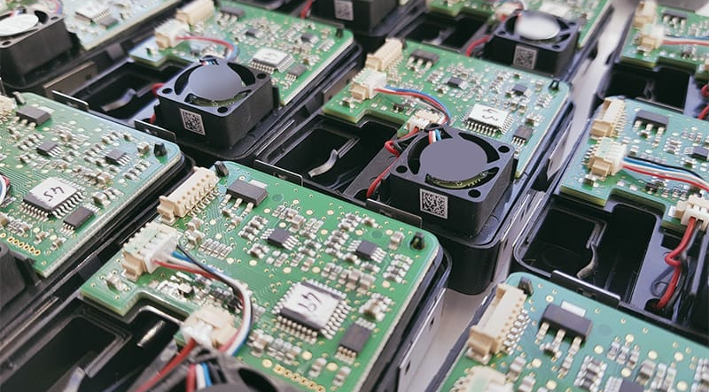
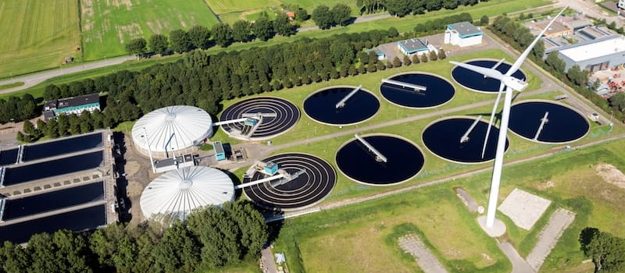
PHOTONICS IN
CLIMATE & ENERGY
EXAMPLES OF SUPPORTED PROJECTS
Wide-area monitoring of power grids through photonic integrated circuit (PIC)-based systems
Developing proof-of-concept components using electron beam lithography (EBL) technology
DISCOVER HOW YOU CAN
Decrease data carbon footprint
Monitor environmental
& climate change
Boost wind & solar energy
Improving the accuracy of sensing systems through optical spectroscopy

Slide 7

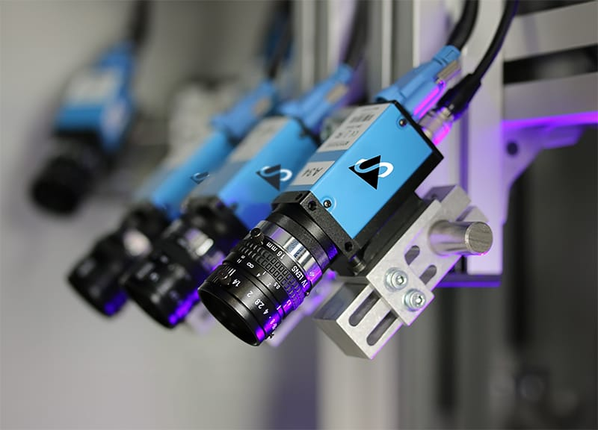
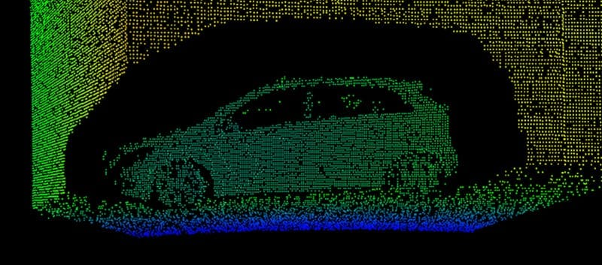
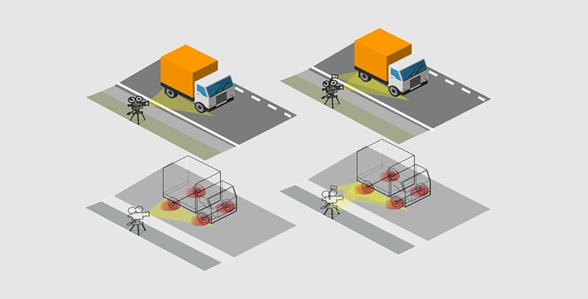
PHOTONICS IN
MOBILITY
EXAMPLES OF SUPPORTED PROJECTS
Developing advanced lens systems for autonomous vehicles
Innovative
low-cost LiDAR systems for autonomous vehicles
DISCOVER HOW YOU CAN
Achieve smart, durable lighting
Improve safety with sensors
Enhance autonomous mobility
Revolutionising Road Safety and Maintenance with Innovative Sensor Technology

Slide 8


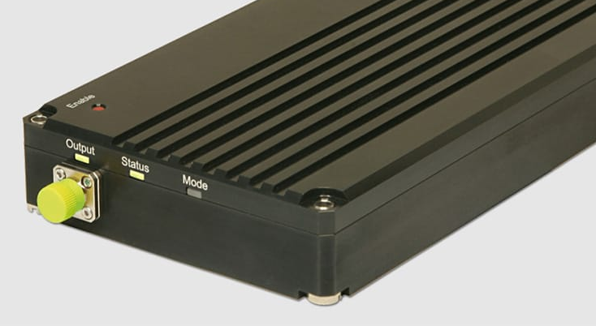

PHOTONICS IN
DIGITAL INFRASTRUCTURE
EXAMPLES OF SUPPORTED PROJECTS
Next-generation entropy source for secure space applications using quantum key distribution
Improving data transmission in
long distance telecommunications
DISCOVER HOW YOU CAN
Reduce energy consumption
Communicate securely
Enhance IoT and VR solutions
Advanced Optical Solutions for Live Sports Video Processing

Slide 9

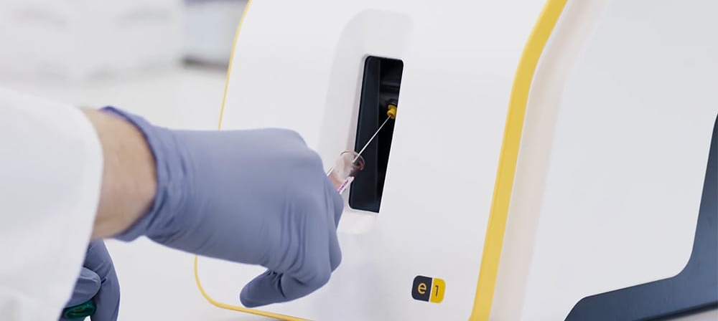
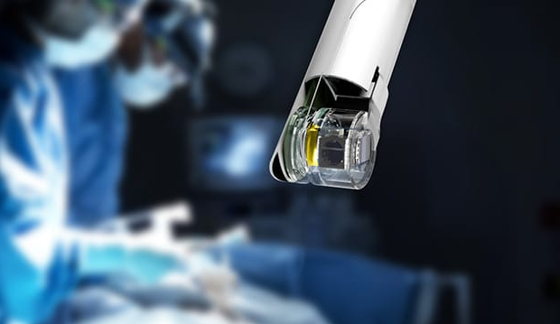
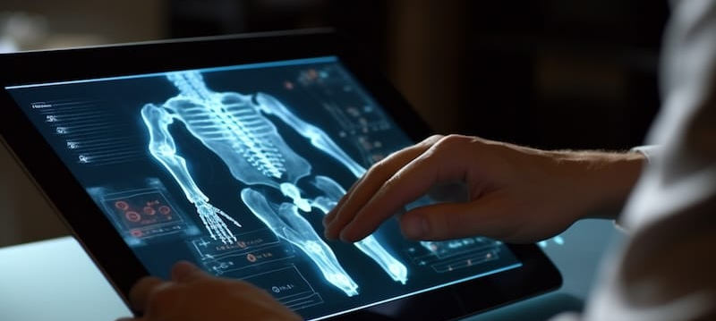
PHOTONICS IN
HEALTH
EXAMPLES OF SUPPORTED PROJECTS
Reducing diagnostic times through optical sensors
Improving procedure accuracy through high-quality illumination and high-resolution imagery
DISCOVER HOW YOU CAN
Boost prevention
Diagnose diseases
Manage chronic conditions
Advance therapy options
Assessing post-operative recovery using remote optical monitoring

Slide 10

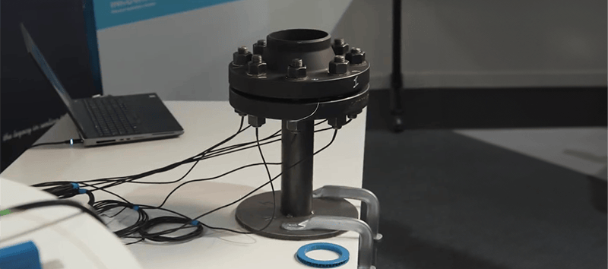

PHOTONICS IN
MANUFACTURING
EXAMPLES OF SUPPORTED PROJECTS
Lens array for imaging systems to automate production lines
Measurements with fibre sensors for the petrochemical sector
DISCOVER HOW YOU CAN
Optimise fabrication yields
Increase product quality
Reduce overall costs
Reducing waste through cutting-edge photonics technologies

Slide 11

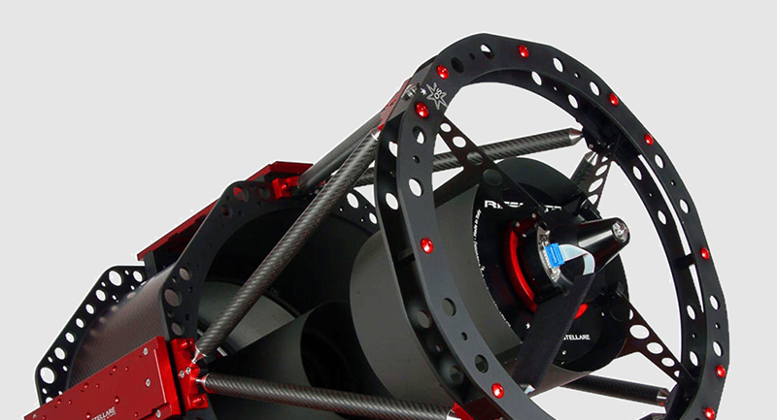
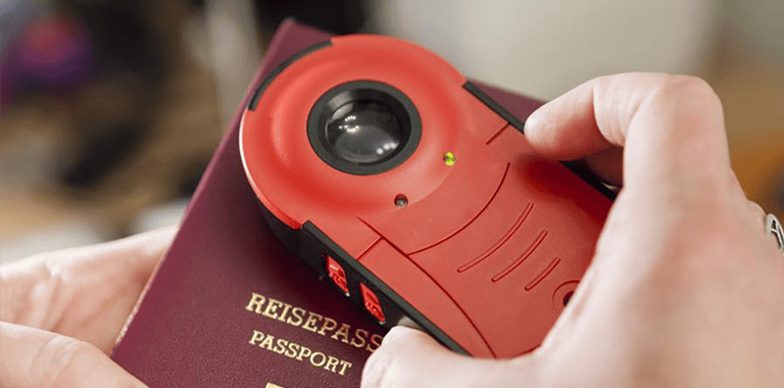
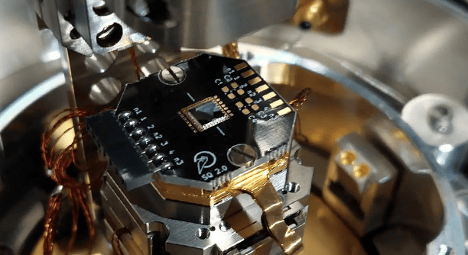
PHOTONICS IN
SAFETY, SECURITY
& SPACE
EXAMPLES OF SUPPORTED PROJECTS
Real-time correction of atmospheric disturbances using adaptive optics with deformable mirrors
Strengthening mobile document security with fluorescent
ink analysis
DISCOVER HOW YOU CAN
Provide secure communications
Improve forensic capabilities
Enhance threat detection
On-Chip Single Photon Source for Secure Cryptosystems and Quantum Technologies

Slide 12









Empowering companies to innovate with photonics support across the entire innovation valley of death
Technology
TRAINING &
RESKILLING
INVESTMENT
COACHING
DEEP TECHNOLOGY
SUPPORT
BUSINESS
COACHING
Business
Financial
ORIENTEERING

Slide 13

European top experts support your innovation providing deep tech support and business & investment coaching
Technology Expertise
Business and
Investment Expertise
Technology Expertise
Expert
Consulting
Knowledge
Team
Training
Team
Conversation
Growth
Advice
Trust
Research
Prototyping Services
Pilot Lines and Foundries
Prototyping Services
Pilot Lines and Foundries
Proof-of-concept (POC)
Prototype
Pilot
Minimum viable product (MVP)

Slide 14
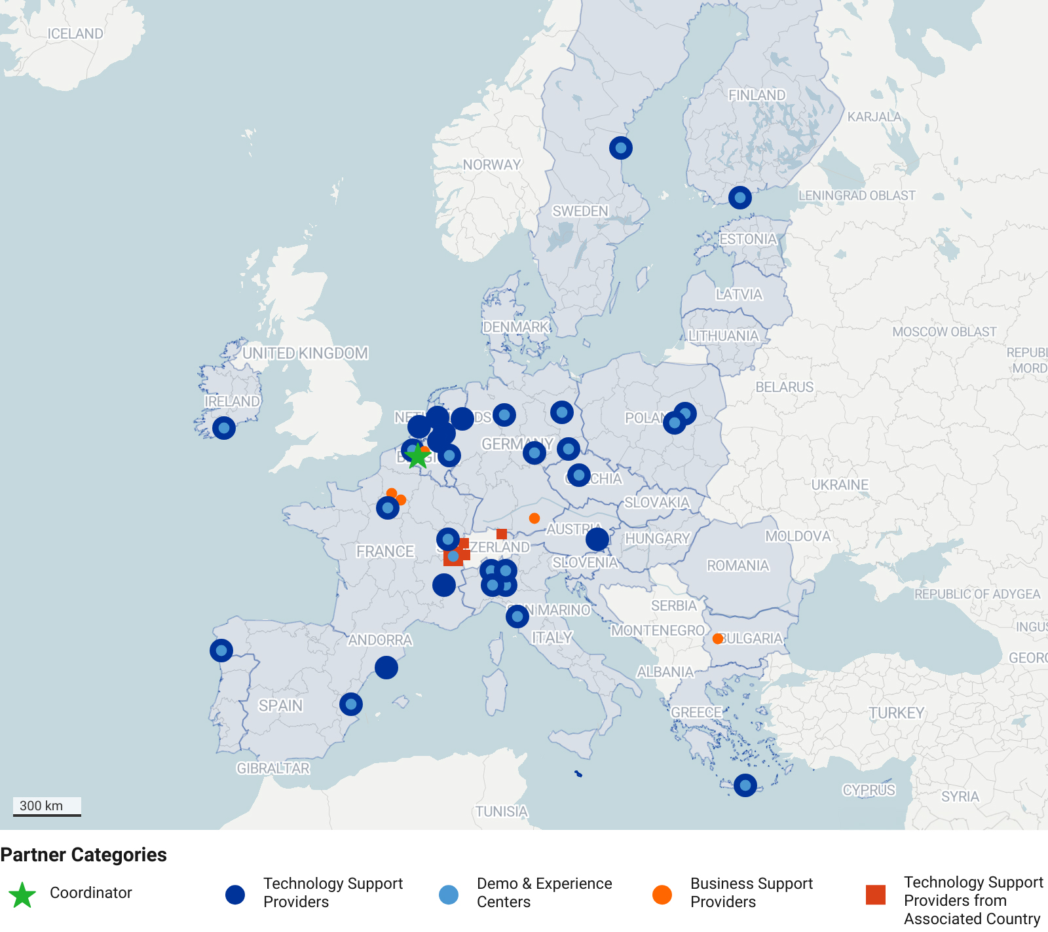
Introducing the project’s partners
30
Technology support partners
3
Business
support partners

Slide 15
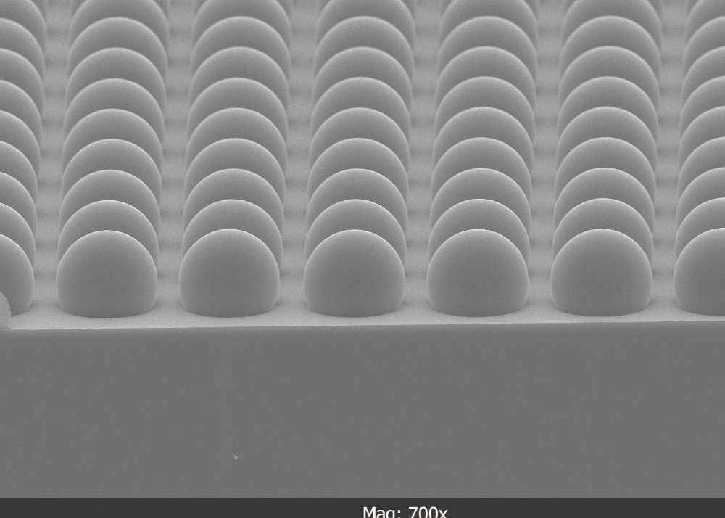
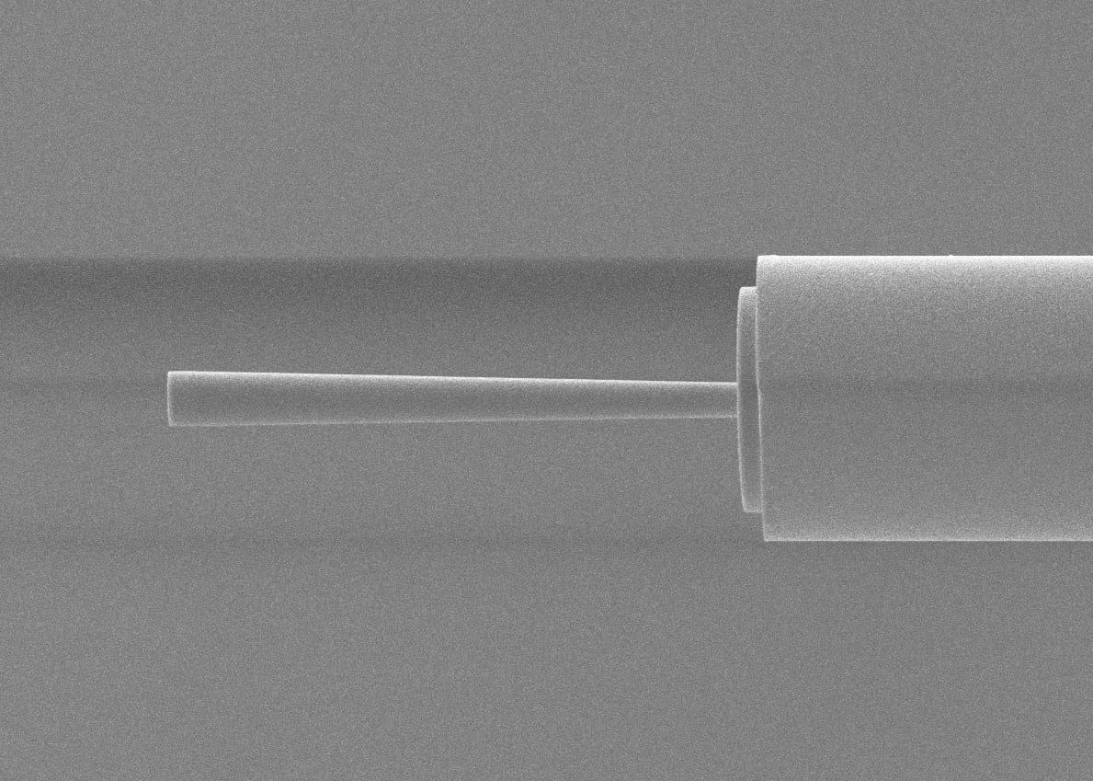
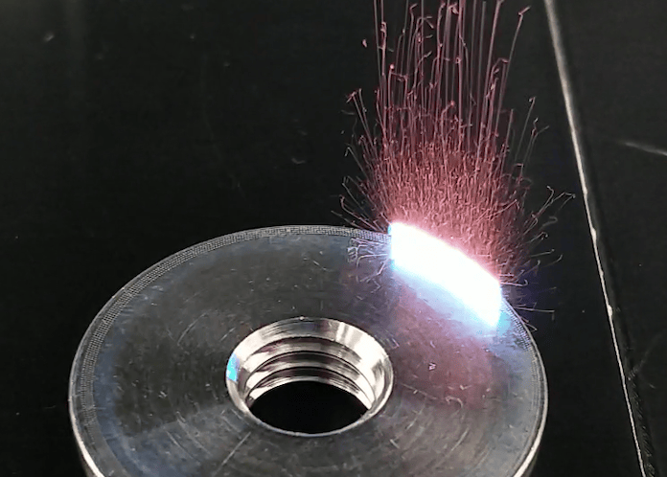
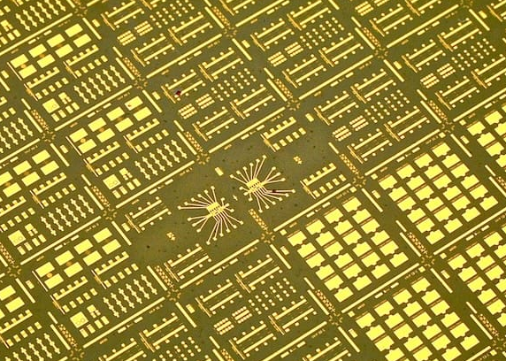

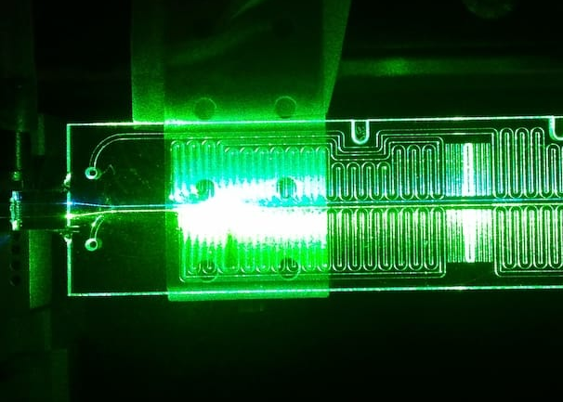
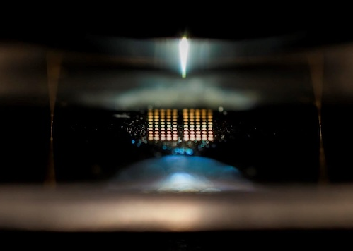
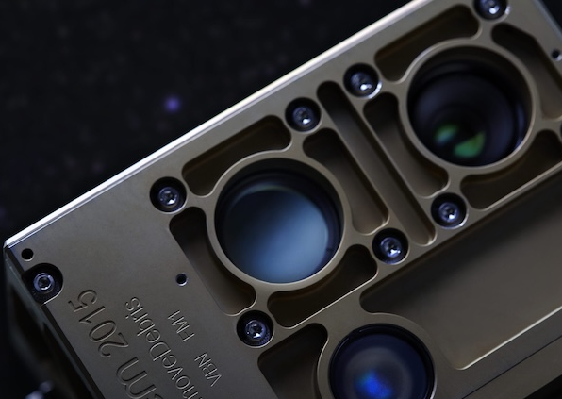
8 technology platforms providing innovation support for prototyping, pilot-line and foundry services
Free-space optics
Specialty fibers
Laser-based manufacturing
Si/SiN PICs
InP PICs
LNOI PICs
MOEMS
Packaging

Slide 16
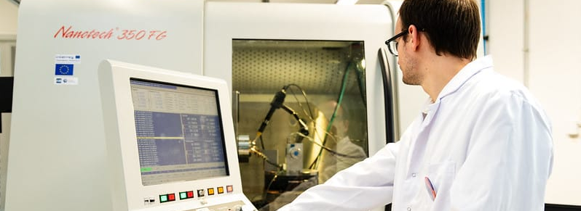
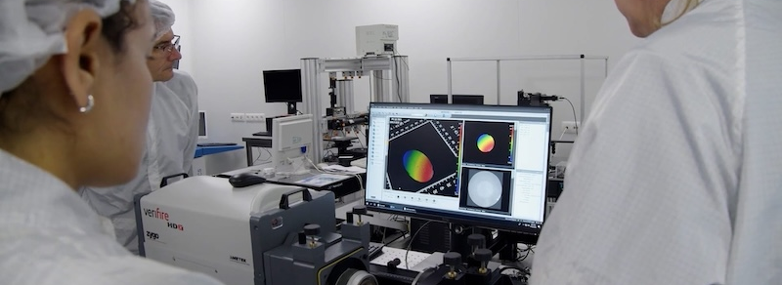

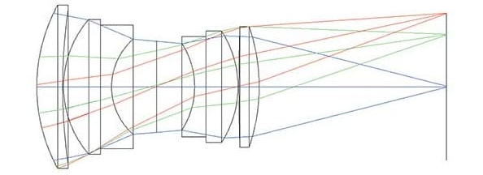
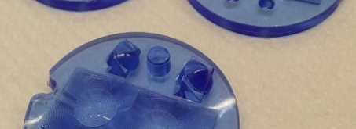
From design and prototyping to upscaling each tech. platform supports the full supply chain with EU manufacturing links
Platform 2
Prototyping and manufacturing
Platform 3
Metrology and quality control
Platform 1
Modelling and design
Platform 4 Proof-of-concept demonstrators and industrial prototypes

Slide 17


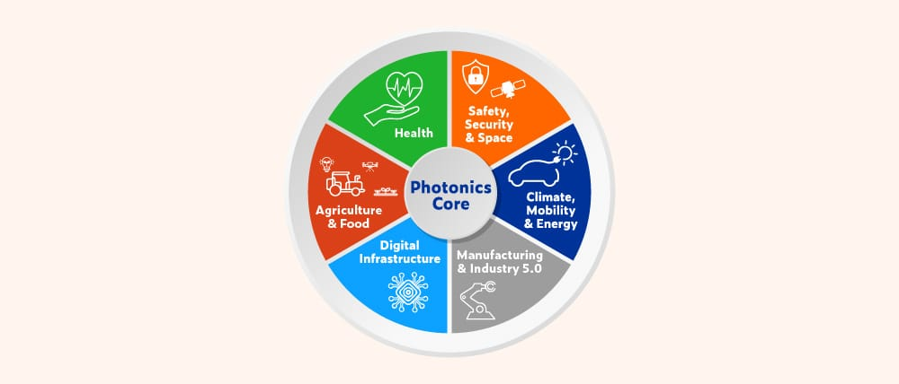



PhotonHub PHACTORY
Key Principles
Innovation driven by business need of companies
Innovation support for SMEs & entrepreneurial-minded researchers
Focus on early adopters targeting
photonics-first companies
Companies receive innovation support instead of funding
Project funding only to
cross-border innovation support
Impact and strategy improvement measured by quantitative KPIs

Slide 18

Strongly subsidised projects up to 85% of the project’s budget
TRL 2-7: Innovation projects
Subsidy Levels
First €40k of innovation project budget fully subsidised; 85% of total budget subsidised thereafter*
(*Except for LSCs where it is 50% of total budget subsidised.)
Illustrative examples:
Total innovation project budget |  | Subsidised by PhotonHub |  | Cash contribution of company
€ 50k € 100k € 220k |  | € 48.5k € 91k € 193k |  | € 1.5k € 9k € 27k
=
+
=
+
=
+

Slide 19
Strongly subsidised projects up to 85% of the project’s budget
IRL 1-9: Business support
Available to EU-companies
Entrepreneurially minded Researchers and Start-Ups
  Launch Pad
Fast Scaling Ventures
  Scaling Club
Photonics-Enabled SMEs and LSCs
  Expert Mentoring

Slide 20
Customised benefits to your company
ONE-STOP-SHOP
Full supply chain of cutting-edge photonics platforms
SEAMLESS SUPPORT
All the way from concept to manufacturing (TLR 3-8) through multiple follow-on projects
SCALING FOCUS
Scaling Club dedicated to guidance on upscaling
CONCRETE RESULTS
TRL advancement of
1-2 TRL levels
FASTER TIME TO MARKET
Projects typically take
6-9 months
BUSINESS ACCELERATION
Customised business and IP coaching to support strategic development
TOP EXPERTS
We select the partners that can best serve your technology needs

Slide 21
6 Steps to launch your photonics innovation
SELECT THE SERVICES OF INTEREST AND REGISTER ONLINE
TECHNOLOGY ORIENTEERING
We will contact you under NDA to explore your photonics ambition and identify the right technology approach and partners.
INITIAL EXPERT ASSESSMENT
Face-to-face expert meeting covering technical and business aspects, followed by a report with next steps (within 2 weeks).
PROJECT
PROPOSAL
Assignment of a project leader to help prepare and submit your tailored innovation proposal.
PROJECT
EVALUATION
Reviewing and scoring your proposal, invites you to an online Q&A, and delivers a formal report within one week.
CONTRACT SIGNING
AND KICK-OFF
Once granted, all partners sign the innovation project agreement and the project kicks off.

Slide 22


photonhub.eu
Start YOUR Supported
Photonics Innovation Journey
Apply online – NOW

