Slide 1
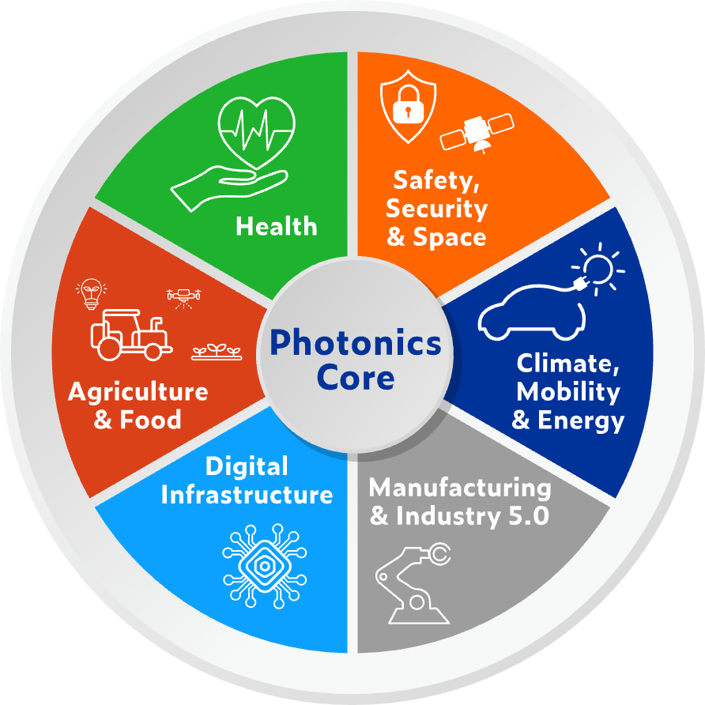


Start your photonics innovation journey with PhotonHub support
Enabling photonics-driven
innovation across all industries
Benefits to your company:
Strongly subsidised support
One-stop-shop access
Leading technology experts
Concrete TRL advancement
Reduced time to market
Customised business coaching
GET STARTED!
PHOTONHUB.EU

